Slide 1
Uplift modeling
for marketing campaign analysis
Julia Wang

Slide 2
Business Objectives
A non-for-profit organization has an upcoming fundraising campaign and the company need analysts to optimize the donation collections through its direct contact campaign
Using predictive modeling to target individuals that are more likely to donate from the one million members(potential donors).
Maximizing the operation surplus : Total amount raised – cost of calls
Number of contacted numbers | Cost per member
0-60000 | $5/person
60000 | $25/person

Slide 3
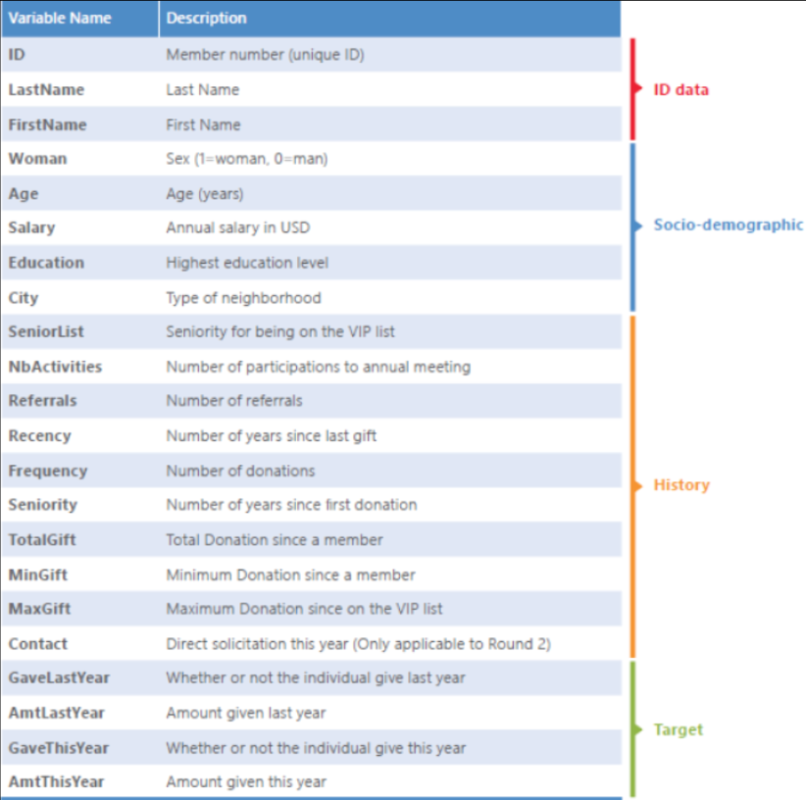
Data Source
1,000,000 potential donors :
ID
Socioeconomic Status
Previous donation behaviors
Data Inspection
40% of the dataset contains missing values
Imputation and creation of dummies

Slide 4
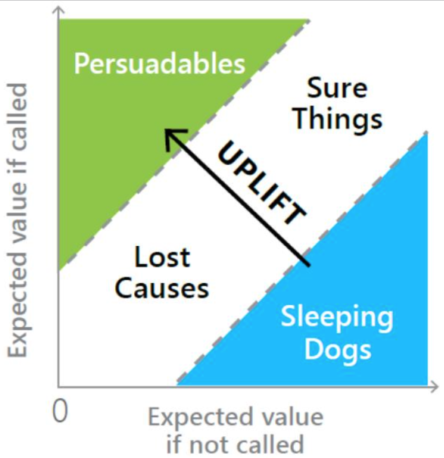
Uplift modeling
What is uplift modeling?
Persuadable: members who only donate because they were called.
Sure Things: members who would have donated whether they were called or not.
Lost Causes: members who will not donate irrespective of whether or not they are called.
Sleeping Dogs: members who are less likely to donate because they were called.
*Identifying the types that the members belong to and calculate the uplift score.

Slide 5
Uplift modeling
PV1= called
PV2= not called
Uplift = PV1 - PV2
Threshold:
1.Uplift value is at least 30
2.The probability of donating, if contacted, is at least 45%

Slide 6



Two-stage Modeling
1.Probability of giving
2.Conditional amount
Logistic regression was created to identify which members should be contacted.
Giving the probability that each individual will give
Keeping only the data from members who gave,
Linear regression was implemented to predict how much a member will donate

Slide 7
Model Performance
Based on validation data, both selections produced an AUC of approximately 0.75
The conditions resulted in 166,984 contact points and yielded $11M surplus.
Regarding the performance of the model, accuracy is relatively high, as the final model currently ranks as the third-highest submission of all the teams analyzing this problem

Slide 8
For future Operation
The individuals on the contact list should be contacted in the upcoming fundraising campaign.
A better data entry and management practice should be implemented to minimize the number of missing values.
Socioeconomic data/variables such as job level, industry household, disposable income, debt and number of dependents would provide an extra layer of information regarding a donor’s financial situation.

